Slide 1
Visualising translation flows in Ibero-American literary magazines
Ventsislav Ikoff ¹, Alessio Cardillo ¹, Laura Fólica ¹, and Diana Roig Sanz ^{2,1}
¹ Internet Interdisciplinary Institute (IN3) – Universitat Oberta de Catalunya – Barcelona, Spain
² Catalan Institution for Research and Advanced Studies (ICREA) – Barcelona, Spain
Workshop on Information Visualization in the (Digital) Humanities
28/10/2022 – University of Graz, Graz (Austria)

Slide 2
Visualising translation flows in Ibero-American literary magazines
OUTLINE
Motivation
Data
Visualization
Network based visualizations
Geographical networks visualization
Flows (Sankey)
Discussion
Take home messages
References

Slide 3


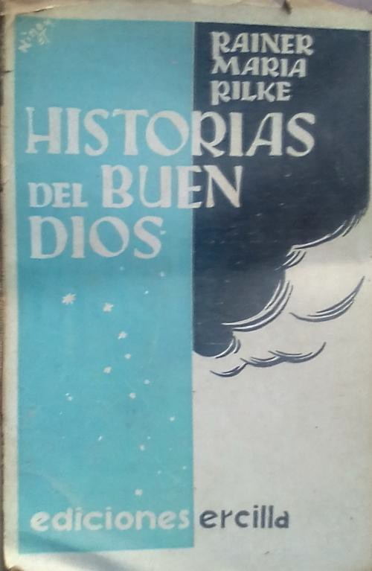

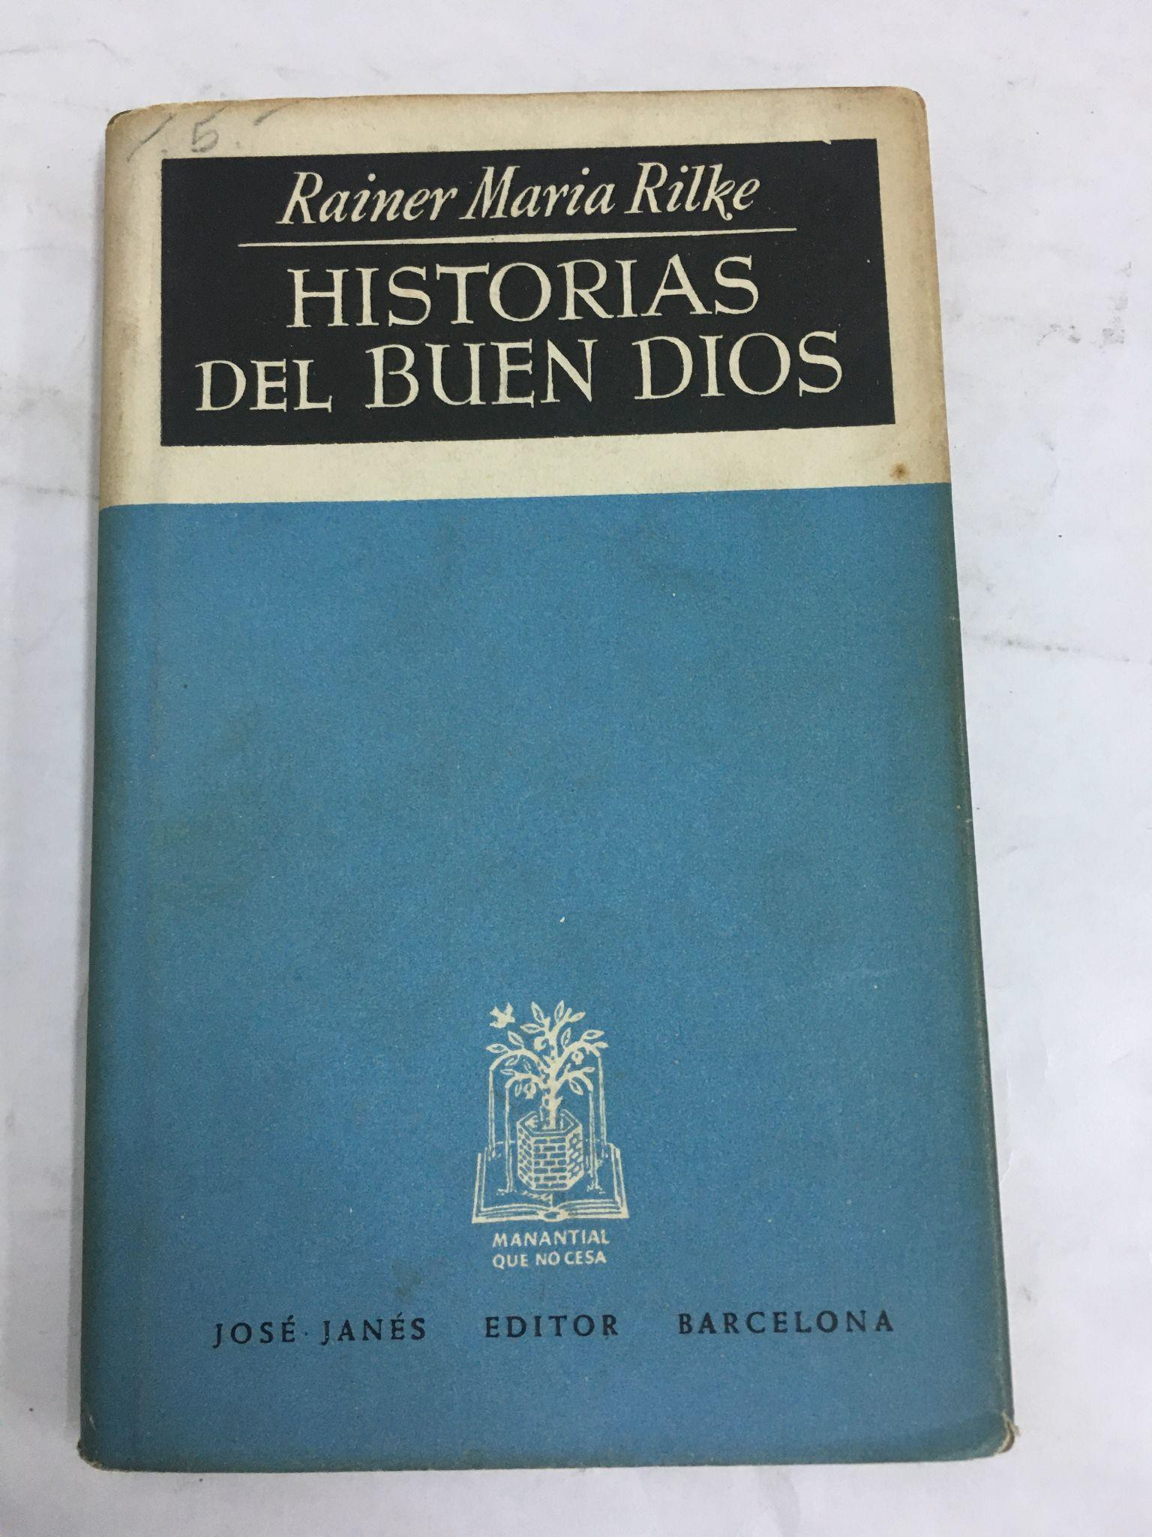
Rainer Maria Rilke. Geschichten vom lieben Gott
Leipzig 1904 Insel-Verlag
Santiago de Chile 1935 Ercilla
Barcelona 1941 Ayma
Barcelona 1948 José Janés

Slide 4
Our research questions
1. How did literary modernity circulate in Ibero-America during the first half of the 20th century?
What translated literature has circulated in magazines at the beginning of the 20th century in Ibero-America?
1. How can we represent visually the translation flows from different literary traditions into Ibero-American literary fields?

Slide 5
Data I
Sources:
Hanno Ehrlicher, Research project "Cultural Magazines from 'Modernismo' to Avant-Garde", funded by the German Research Foundation (DFG), grant no. 327964298. < https://doi.org/10.20375/0000-000D-1CFF-6 >
Diana Roig-Sanz, R+D project "Mapping Hispanic Modernity. Cross-border Literary Networks and Cultural Mediators (1908-1939)" (FFI2016-76055-P), funded by the Spanish Ministerio de Economía, Industria y Competitividad.

Slide 6

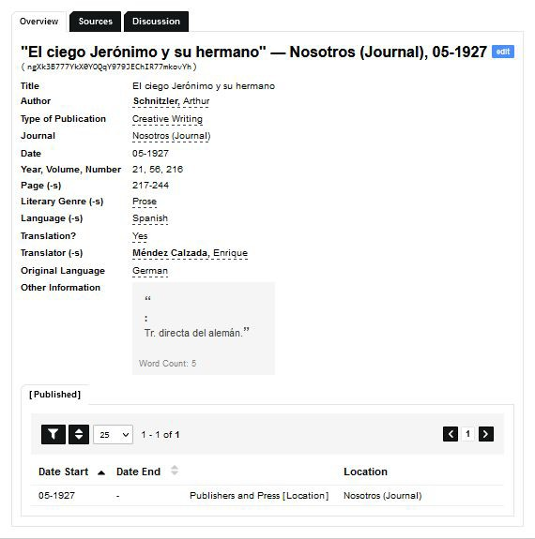
Data II
Feature | Value
Time span | 1907 – 1943
Nr. of magazines | 8
Nr. of articles | 925
Nr. of authors | 525
Nr. of countries* | 39
Nr. of languages | 27

Slide 7
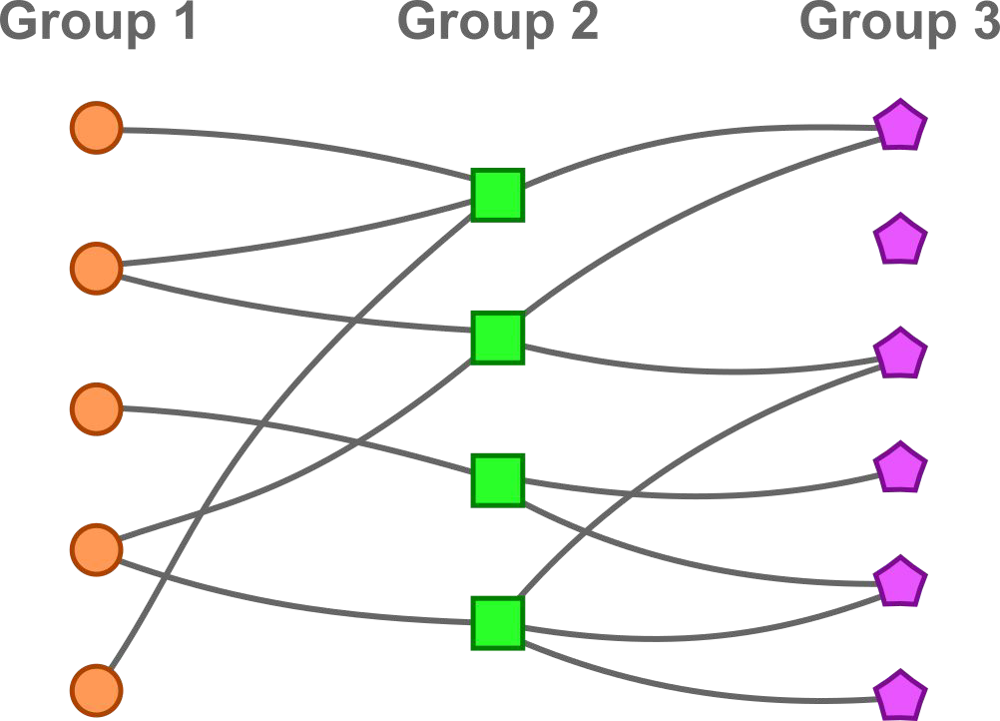
Networks
Nodes: authors, countries, languages, magazines
Edges: translations
Relations only between different types of nodes.
Bi-partite networks:
author - magazine
country - magazine
language - magazine
etc.
Tri-partite networks:
author - language - magazine
country - language - magazine

Slide 8
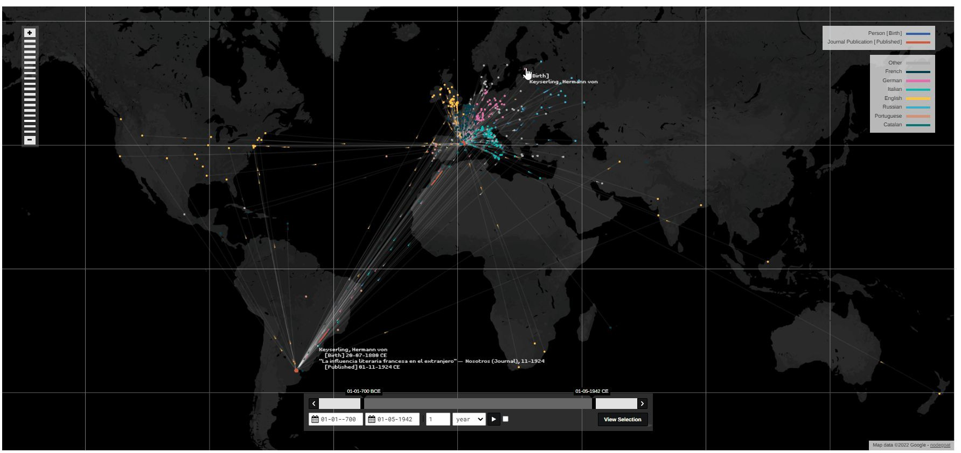
Interactive visualization with Nodegoat
https://nodegoat.net/

Slide 9
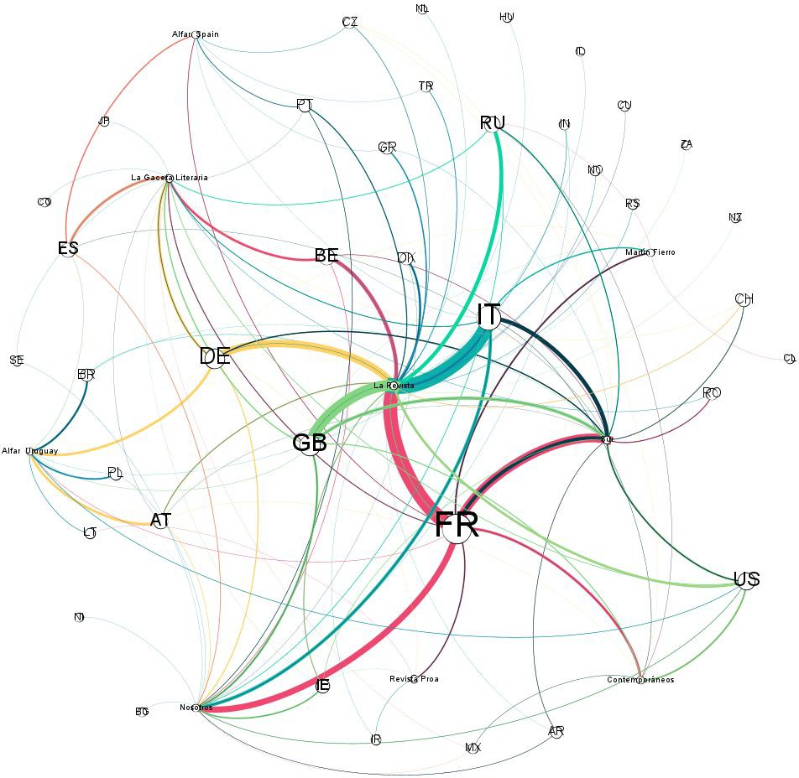
Static network visualization
Literary translation as a network of:
48 nodes
39 countries of author’s nationality
9 journal location
180 weighted edges (pairs country-journal)
https://gephi.org/

Slide 10
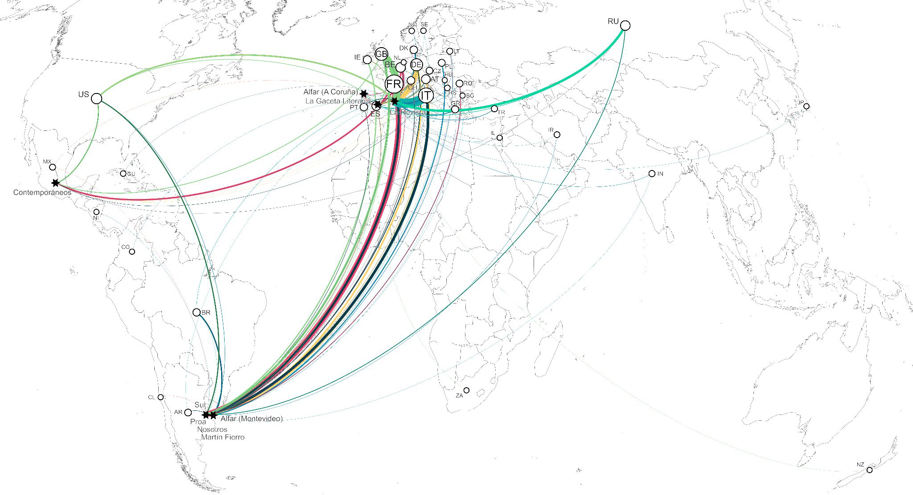
Static geographical network visualization

Slide 11
Visualizing flows
We can leverage the intrinsic structure of our data (in particular the presence of different types of actors) to display translation’s flows between countries and languages and languages and magazines.
One way is to build a so-called tri-parite (or N-partite) network where interactions occur only between distinct types of nodes.
Sankey diagrams are a native way to encapsulate the information into an N-partite network. They highlight natively the most important flows between distinct groups of categories.

Slide 12
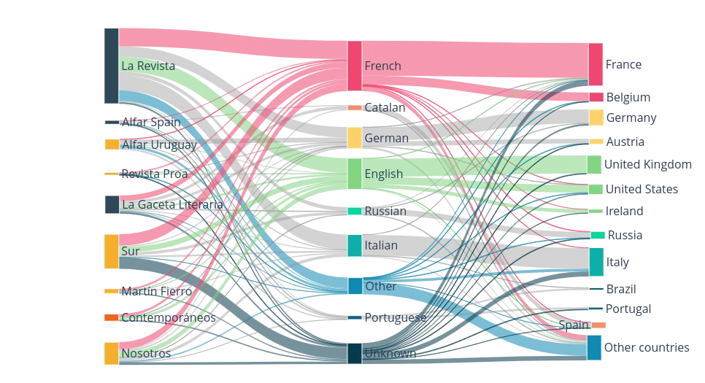
Sankey diagram
https://plotly.com/python/

Slide 13
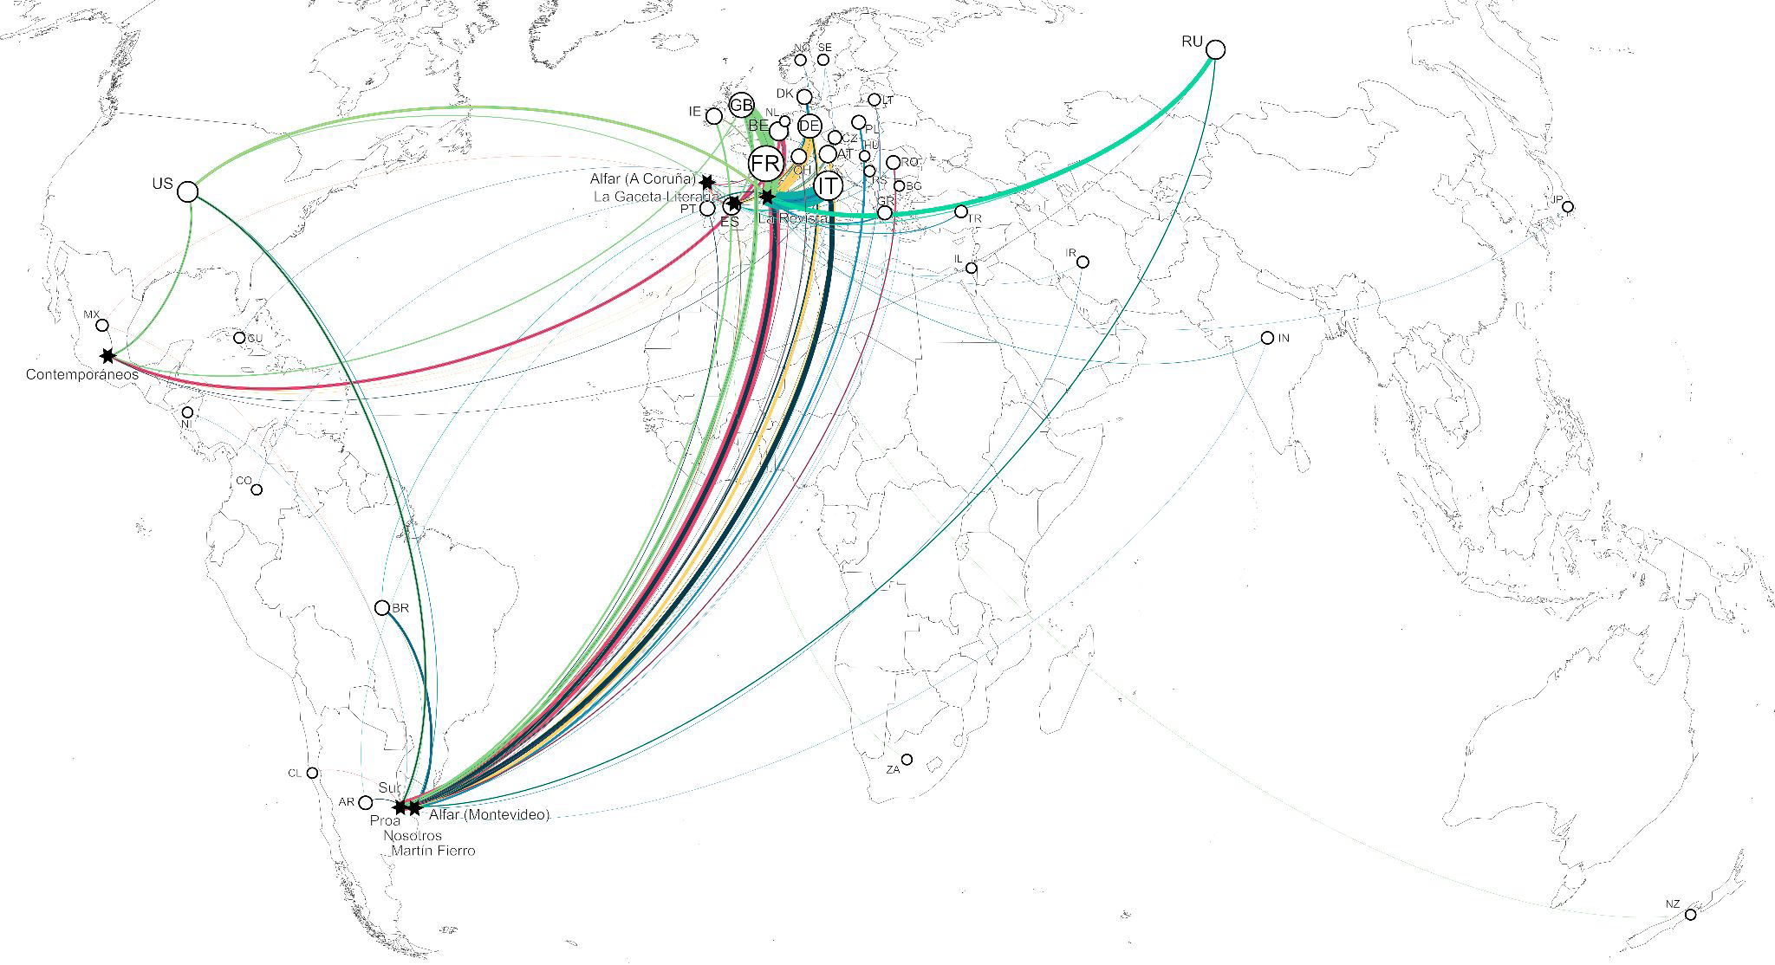
Different perspectives

Slide 14
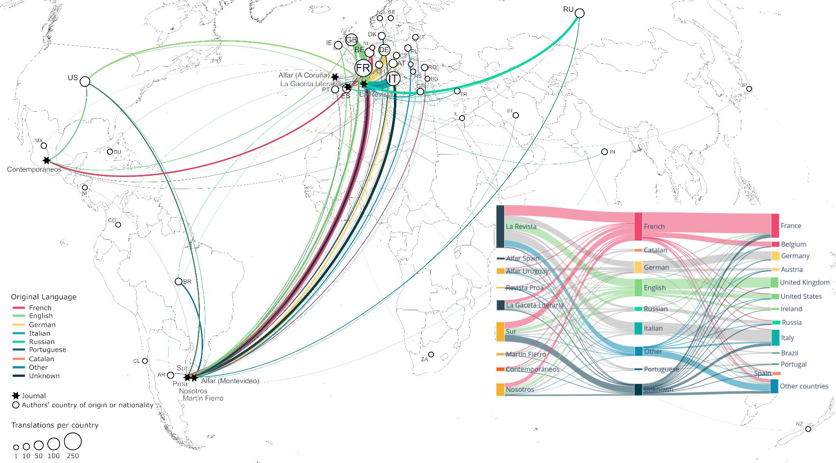
Composite

Slide 15
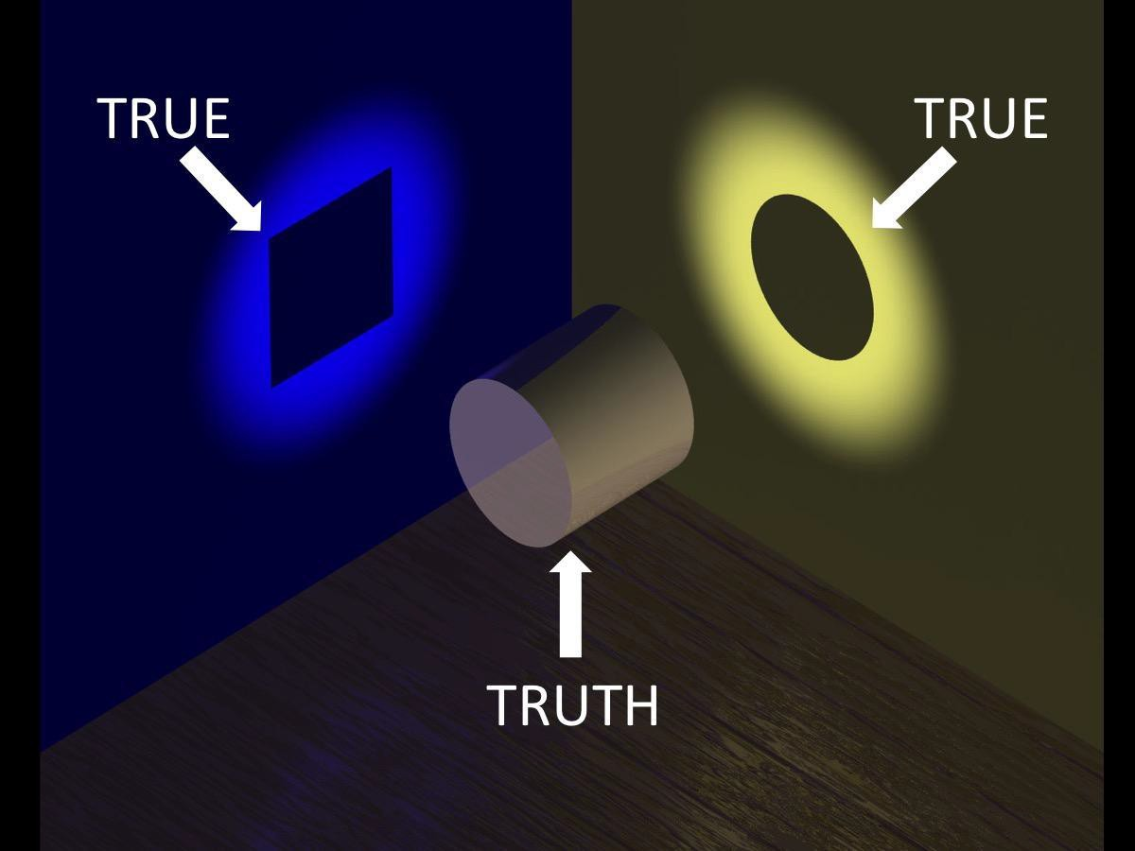
Take home messages
Brief recap of the research question → main results
Limitations
Future research
Perspective (same data →
different perspective)

Slide 16

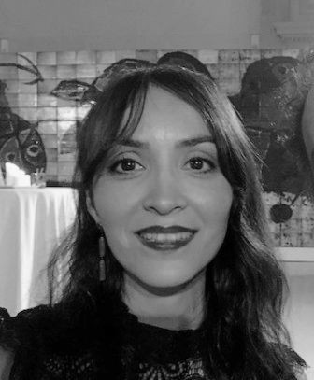
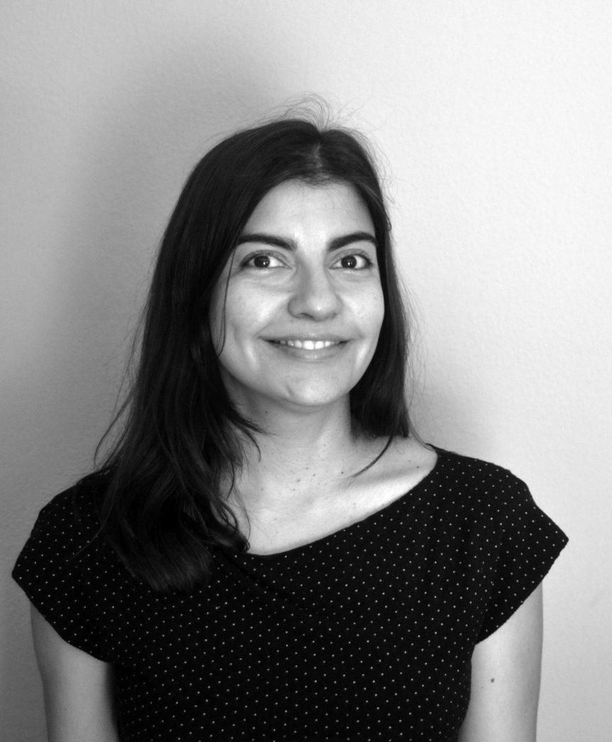




Acknowledgment
Further questions, ideas and comments?
Diana Roig Sanz
Laura Fólica
vikoff@uoc.edu
Social Networks of the Past. Mapping Hispanic and Lusophone Literary Modernity, 1898-1959
Alessio Cardillo
Ventsislav Ikoff

Slide 17
References
Bastian M., Heymann S., and Jacomy M. (2009): Gephi: an open source software for exploring and manipulating networks. International AAAI Conference on Weblogs and Social Media.
Inkscape Developers. (2021): Inkscape 1.1.2. Available at: https://inkscape.org.
Javed, W. and Elmqvist, N. (2012): “Exploring the Design Space of Composite Visualization”, Proceedings of IEEE Pacific Visualization Symposium, pp. 1–8. doi:10.1109/pacificvis.2012.6183556
Latora, V., Nicosia, V., and Russo, G. (2017): Complex Networks. Cambridge, UK: Cambridge University Press.
Plotly open source graphic library for Python. Available at: https://plotly.com/python/
Roig-Sanz, D., and Fólica, L. (2021): "Cartografía de la modernidad hispánica: las revistas literarias como redes. Un modelo para un análisis a gran escala", Del ductus al XML: recorridos por las edades del libro (dir. Marina Garone Isabel Galina Russell, Laurette Godinas y Marina Garone Gravier), Prensas de la Universidad Autónoma de México, 557-581.
Wilke, Claus O. (2019): Fundamentals of Data Visualization: A Primer on Making Informative and Compelling Figures. Sebastopol, CA: O'Reilly Media.

